Slide 1
Richard Meier
By Akila R and Ananthi

Slide 2
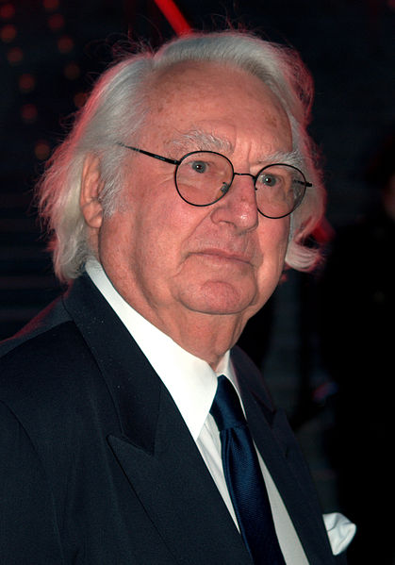
History
Richard Meier was born in New Jersey on October 12, 1934.
Meier earned a Bachelor of Architecture degree from Cornell University in 1957.

Slide 3
History
His early experience included work with the firm of Skidmore, Owings and Merrill (SOM) in New York City and with Marcel Breuer, a noted architect.
After graduation, he travelled to Israel, Greece, Germany, France, Denmark, Finland and Italy, among other places, to network with architects.
Much of Meier's work builds on the work of architects of the early to mid-20th century, especially that of Le Corbusier.

Slide 4
Main Characteristics of Richard Meier Architecture
Richard Meier Architecture had many stages of evolution , but it eventually settles in the pattern which has the following features:
In terms of Form
In terms of Colours
In terms of Materials
In terms of Lighting

Slide 5
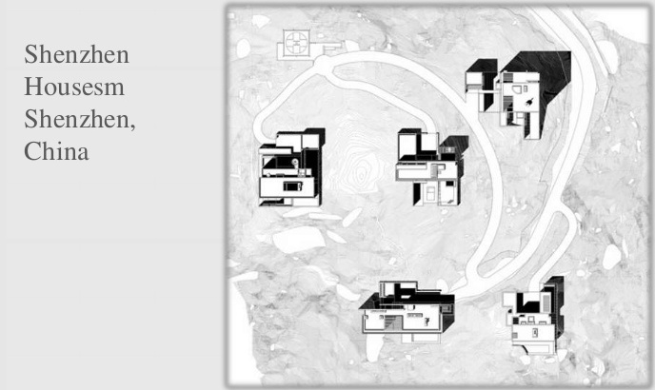
Form : Using Basic Shapes

Slide 6
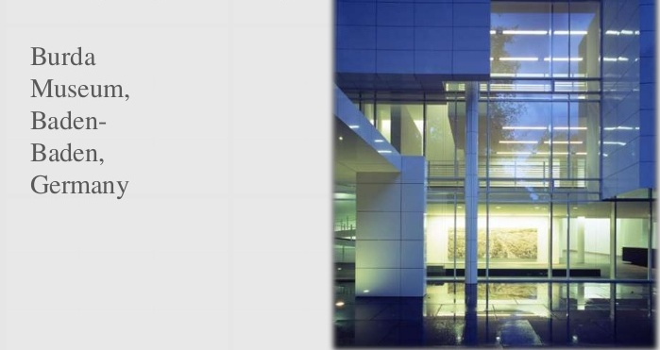
Form : Using grid visually and physically

Slide 7
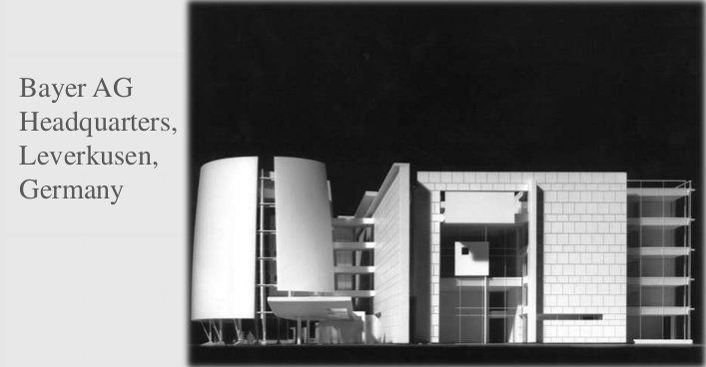
Form : Using Layering

Slide 8
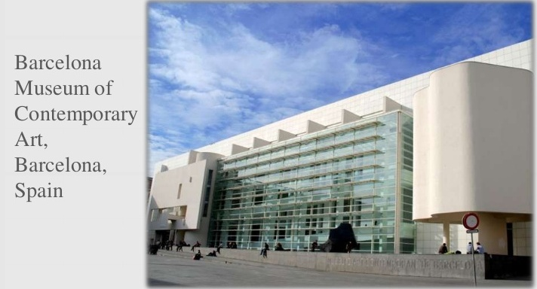
Form : Openness

Slide 9
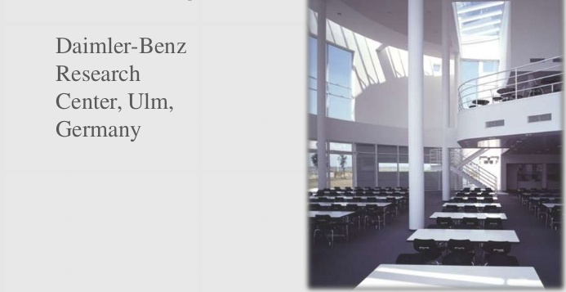
Colours : White (External and Internal)

Slide 10
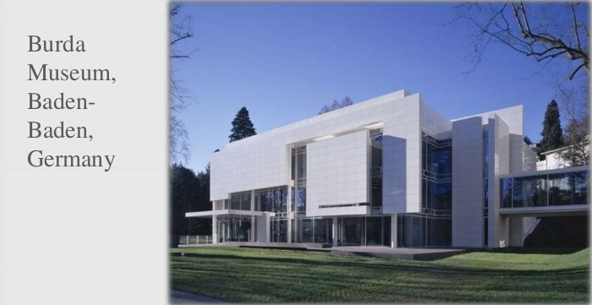
Materials : White Alucobond with Glass

Slide 11
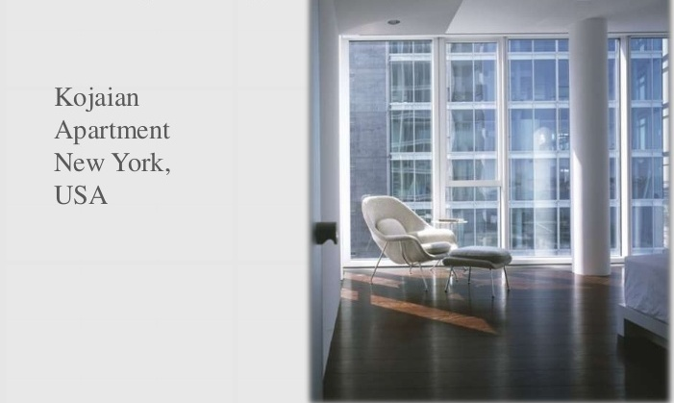
Lighting

Slide 12
Some works by Richard Meier
The Getty Center in Los Angeles, California, it is The largest Meier project At all, It took 13 years to build.

Slide 13
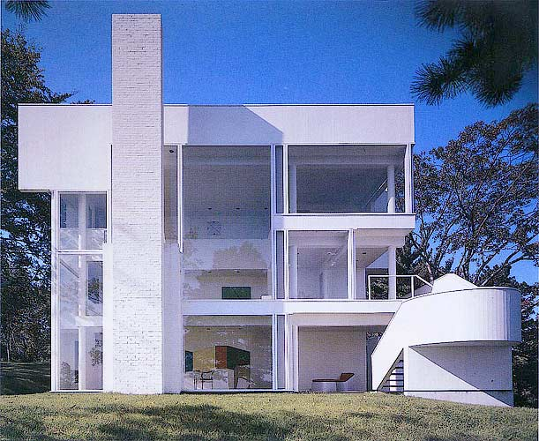
Smith House in Darien, Connecticut

Slide 14
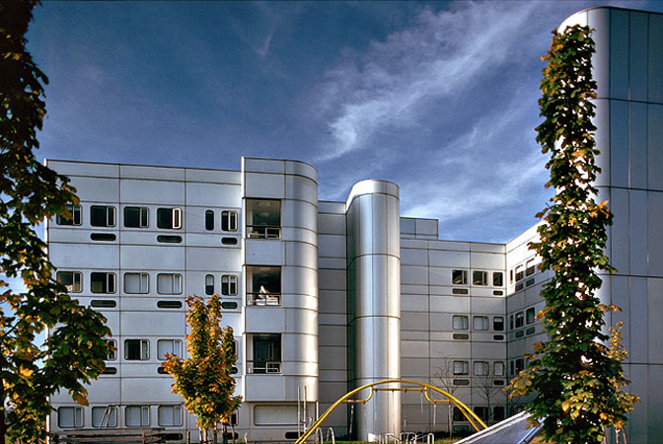
Bronx Developmental Center in The Bronx, New York, it was one of the his earliest large buildings of Alucobond.

Slide 15
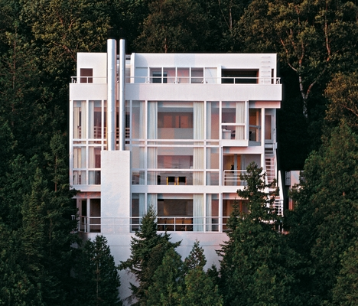
Douglas House in Harbor Springs

Slide 16
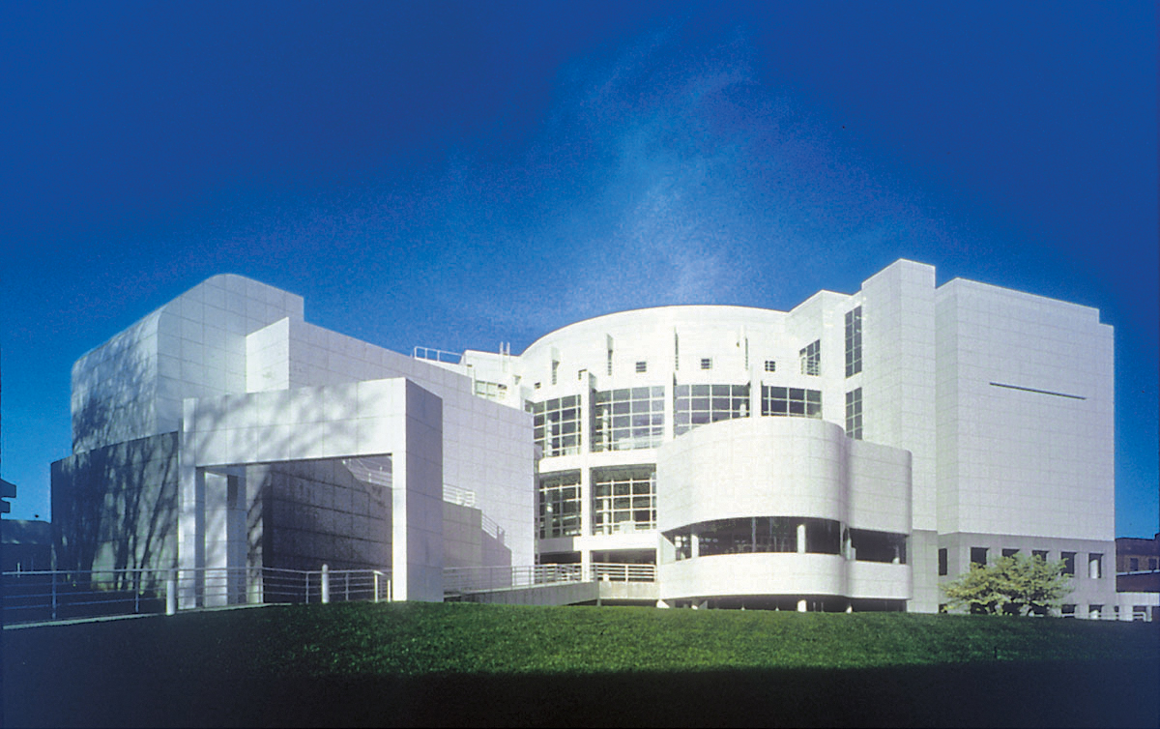
The High Museum of Art in Atlanta, Georgia

Slide 17
Some other works of Richard Meier
The Atheneum, New Harmony, Indiana, 1979
City Hall and Central Library, The Hague, Netherlands, 1995
Edinburgh Park Masterplan, 1995
Rachofsky House, Dallas, Texas, 1996
Neugebauer House, Naples, Florida, 1998
Camden Medical Centre, Singapore, 1998
White Plaza, Basel, Switzerland, 1998
Meier Tower, Tel Aviv, Israel

Slide 18
The Smith House
Located in Darien, Connecticut.
Built from 1965 to 1967.
Style : Modern.
The spatial organization of the house hinges on the programmatic separation between public and private areas.
From the front walkway, visitors approach a mostly opaque white wood facade before crossing a ramp and entering on the house’s second level to discover what Meier calls a "180-degree explosion" of light and space.

Slide 19
Smith House
The living room, dining area, and study embrace the waterfront views, pinwheeling in a three-level enclosure of glass on three sides.
The family’s private quarters, meanwhile, are stacked at the street facing facade of the building.
Elements that would become Meier signatures are present as well: the pristine white exterior, expanses of plate glass framed by finely proportioned piers and mullions, and minimal interiors creating intersecting volumes.

Slide 20
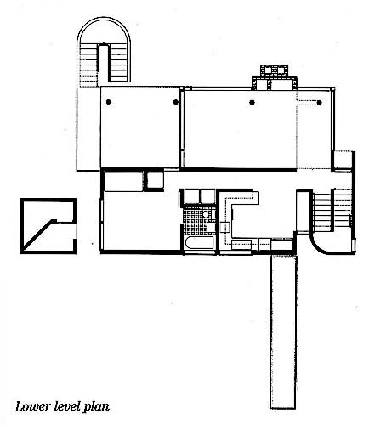
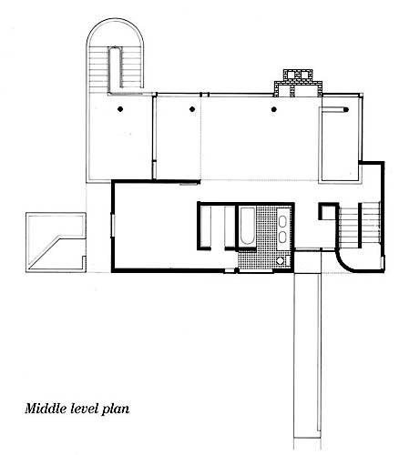
Smith House - Plan

Slide 21
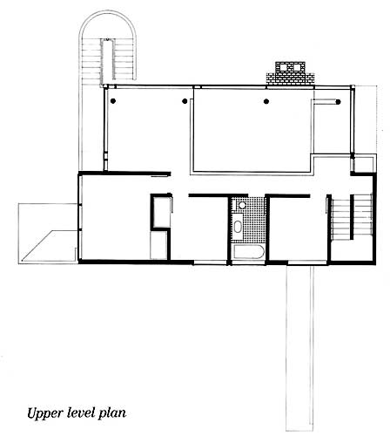
The Smith House

Slide 22
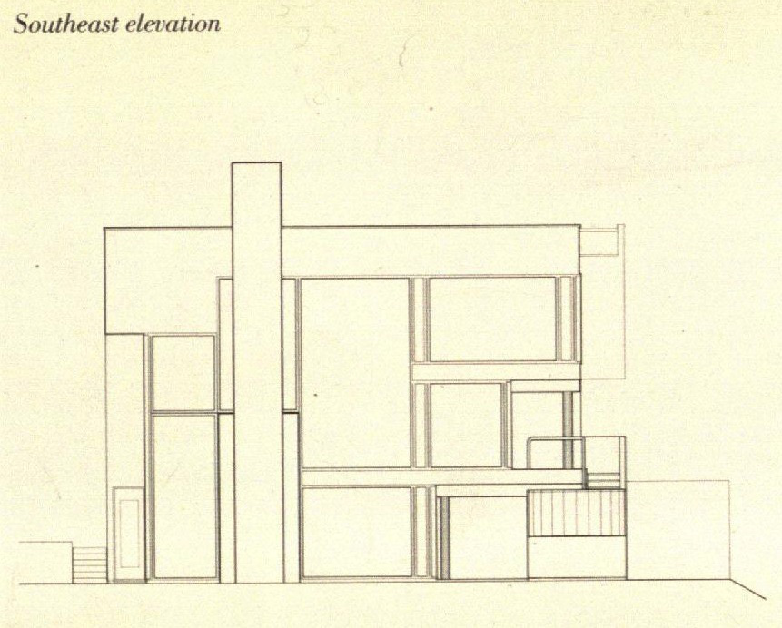
The Smith House

Slide 23
The Douglas House
Location :Harbor Springs, Michigan.
Year : 1973
The Douglas House is dramatically situated on an isolated site that slopes down to Lake Michigan.
The entry to the house extends beyond the building envelope.
Here, as the sharp downhill grade of the land requires the house to be entered at roof level, it takes the form of a flying bridge that seems to shear off the top of the frontal plane.

Slide 24
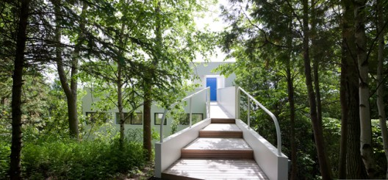
Entry

Slide 25
Douglas House
Horizontal circulation moves along four open corridors, stacked one above the other behind a screen wall. Internal and external staircases provide vertical passage at the corners.
A skylight running nearly the full length of the roof-deck focuses sunlight into the living room, reinforcing the separation between the public and private sectors of the house.

Slide 26
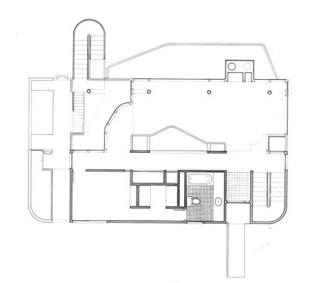
Douglas House Plan

Slide 27
Conclusion
The absence of colour is an intrinsic characteristic of his works; his philosophy is grounded in using light as the main material to give form to his orderly, sculptural, and linear architecture. Profoundly influenced by Le Corbusier, Richard Meier refines his principles of geometrical progression by playing with structure, space and elements of formal precision. “The way that light traverses and cuts through buildings is the interrogative and the principal magic from whence Richard Meier’s projects are born.

